Slide 1


Slide 2
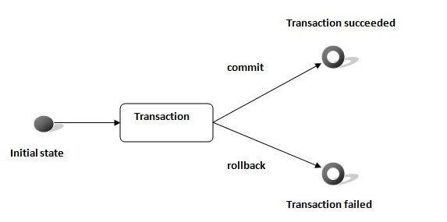
Hibernate Transaction

Slide 3
Hibernate Transaction
A Transaction is a unit of work in which all the operations must be executed or none of them. To understand the importance of transaction, think of an example which applies on all of us i.e. Transferring Amount from one account to another as this operation includes the below two steps:
Deduct the balance from the sender’s bank account
Add the amount to the receiver’s bank account
Now think a situation where the amount is deducted from sender’s account but is not delivered to receiver’s account due to some errors. Such issues are managed by the transaction management where both steps are performed in a single unit. In the case of a failure, the transaction should be roll-backed

Slide 4
Hibernate Transaction
The methods of Transaction interface are as follows:
void begin() starts a new transaction.
void commit() ends the unit of work unless we are in FlushMode.NEVER.
void rollback() forces this transaction to rollback.
void setTimeout(int seconds) it sets a transaction timeout for any transaction started by a subsequent call to begin on this instance.
boolean isAlive() checks if the transaction is still alive.
void registerSynchronization(Synchronization s) registers a user synchronization callback for this transaction.
boolean wasCommited() checks if the transaction is commited successfully.
boolean wasRolledBack() checks if the transaction is rolledback successfully.

Slide 5

Hibernate Transaction

Slide 6
Hibernate Transaction
Atomicity: Is defined as either all operations can be done or all operation can be undone
Consistency: After a transaction is completed successfully, the data in the datastore should be a reliable data. This reliable data is also called as consistent data
Isolation: If two transactions are going on the same data then one transaction will not disturb the other transaction
Durability: After a transaction is completed, the data in the datastore will be permanent until another transaction is going to be performed on that data

Slide 7
HQL – Positional Parameters
Query query = session.createQuery("from Student where studentId = ? and studentName=?");
query.setInteger(0, 1).setString(1, "Jack");

